Slide 1
Funding and Financing

Slide 2
Sources of Funding:
SecureNet Solutions plans to secure funding through a combination of sources:

Slide 3
Sources of Funding (ctd):
Initiating the venture, we will allocate our personal funds to meet imperative initial expenses, encompassing office accommodation, necessary equipment, and preliminary marketing undertakings.
We will actively pursue investment from esteemed local angel investors who deeply resonate with our shared vision of fortifying cybersecurity in Jamaica.

Slide 4
Sources of Funding (ctd) :
These distinguished investors possess a wealth of invaluable wisdom, guidance, and financial backing, offering us an extraordinary opportunity to thrive.
Venture capital. As our business gains momentum and shows growth potential, we will explore partnerships with venture capital firms that specialize in technology and cybersecurity startups.

Slide 5
Sources of Funding (ctd) :
In order to engage the community and foster a deeper understanding of the importance of cybersecurity, we envision embarking upon a captivating crowdfunding endeavor that would entice numerous individuals to contribute modest investments.
By casting a wider net and gathering support from a diverse array of backers, we aim to generate heightened awareness surrounding this critical issue.

Slide 6


Slide 7
Creating a Compelling Pitch:
A successful pitch will emphasize the following points:

Slide 8
Creating a Compelling Pitch (ctd):
The burgeoning cyber threats confronting businesses in Jamaica necessitate the implementation of all-encompassing cybersecurity solutions.
Our value proposition lies in our ability to clearly articulate our unparalleled expertise, tailor our solutions to meet individual needs, leverage cutting-edge technology, and offer proactive monitoring services.

Slide 9
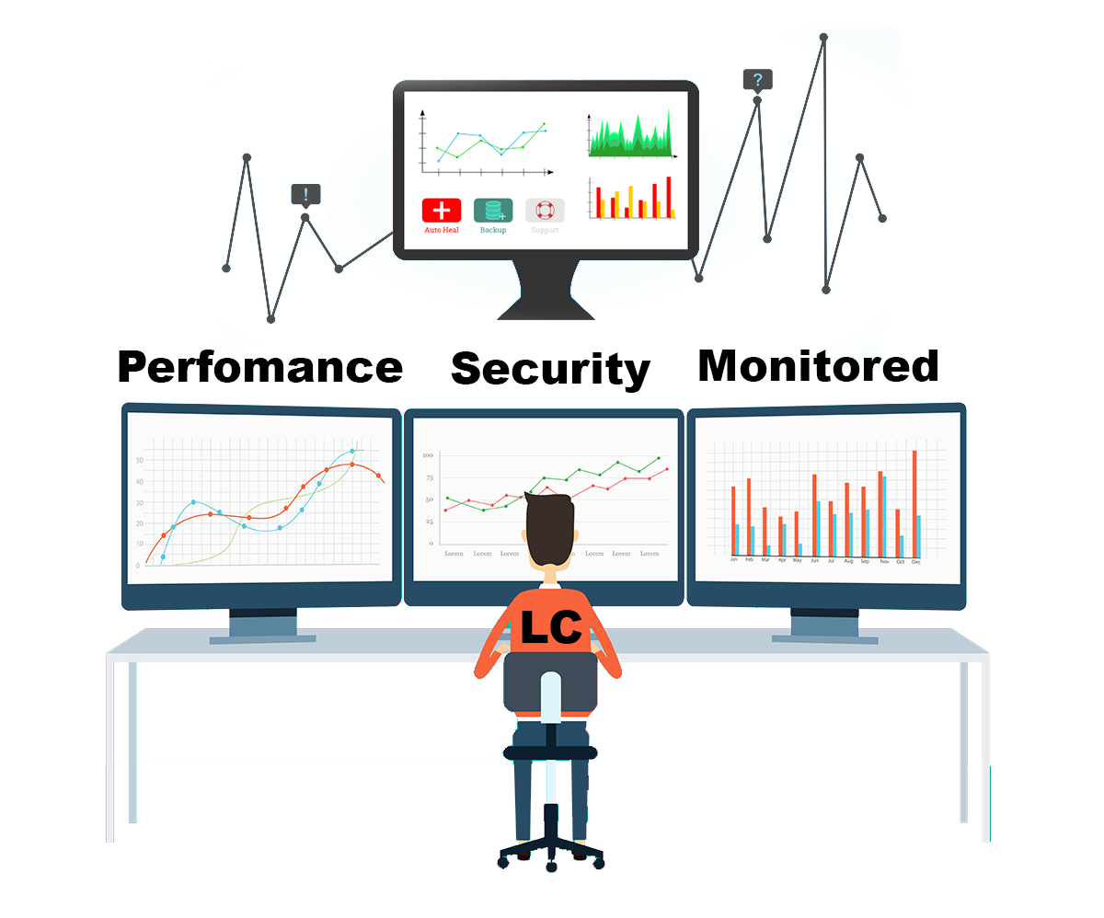

Infographics of our cutting edge cybersecurity technology as well as our monitoring system

Slide 10
Creating a Compelling Pitch (ctd):
Market Opportunity: Highlight the immense potential for expansion within the flourishing cybersecurity sector in Jamaica, while emphasizing the strategic advantage that SecureNet Solutions possesses to seize this favorable circumstance.
We take great pride in presenting our esteemed cybersecurity team, composed of highly accomplished experts whose qualifications and extensive industry experience are second to none.

Slide 11
Creating a Compelling Pitch (ctd):
Financial Projections: Offer a captivating glimpse into the realm of financial possibilities, showcasing the potential for substantial returns on investment.
Highlight the significant and commendable outcomes that arise from enhancing cybersecurity measures, not only for enterprises but also for the broader digital terrain in Jamaica.

Slide 12
Financial Projections and Budgeting:
Financial projections for the first three years are as follows (all figures are in Jamaican Dollars):

Slide 13
Financial Projections and Budgeting:
Year | Revenue | Expenses | Net Income
Year 1 | 3,000,000 | 2,200,000 | 800,000
Year 2 | 5,500,000 | 3,800,000 | 1,700,000
Year 3 | 8,000,000 | 5,000,000 | 3,000,000

Slide 14
Budget Allocation:
Personnel: 40% (salaries, benefits, training)
Technology and Tools: 20% (software licenses, hardware, monitoring tools)
Marketing and Sales: 15% (online/offline marketing, networking events)
Office and Infrastructure: 10% (office space, utilities, equipment)
Operational Costs: 10% (administration, legal, insurance)
Research and Development: 5% (continuous learning, staying updated on cybersecurity trends)

Slide 15
Managing Cash Flow:
Efficient management of financial resources is imperative in order to ensure the continuous progression and prosperity of our endeavors.
Thorough Financial Planning: Craft a meticulous budget blueprint, delineating monthly expenditures and anticipated revenue.

Slide 16
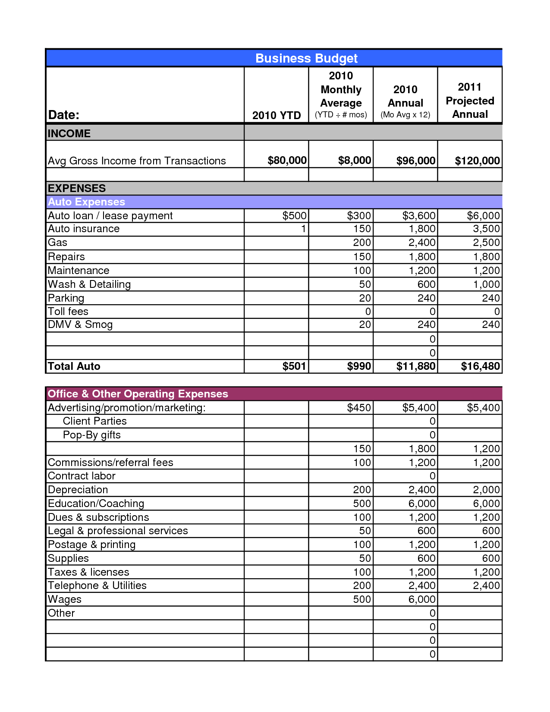
Examples of how our budget could look:

Slide 17
Managing Cash Flow (ctd) :
Invoice Monitoring: Maintain vigilant oversight of client payments and vendor invoices in order to guarantee prompt remittance and circumvent impediments to cash flow.
Establish a prudent financial measure by earmarking a portion of our revenue as a contingency fund, embracing the foresight to effectively navigate unforeseen expenditures or oscillations in our revenue streams.

Slide 18
Managing Cash Flow (ctd) :
Invoice Terms: Articulate and delineate the terms of payment to inspire and motivate clients to settle their dues promptly.
Consistent Evaluation: Engage in periodic assessment of cash flow patterns to discern prevailing trends, strategize for growth, and execute well-informed financial choices.

Slide 19
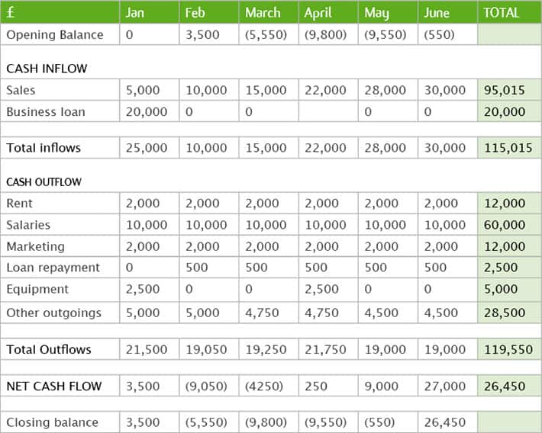

Samples of a cash flow statement and payment agreement template that could be used by our organization

Slide 20
Managing Cash Flow (ctd) :
Through the meticulous management of cash flow, SecureNet Solutions can ensure a steadfast stability, capitalize on emerging growth prospects, and impeccably meet all financial obligations.

Slide 21
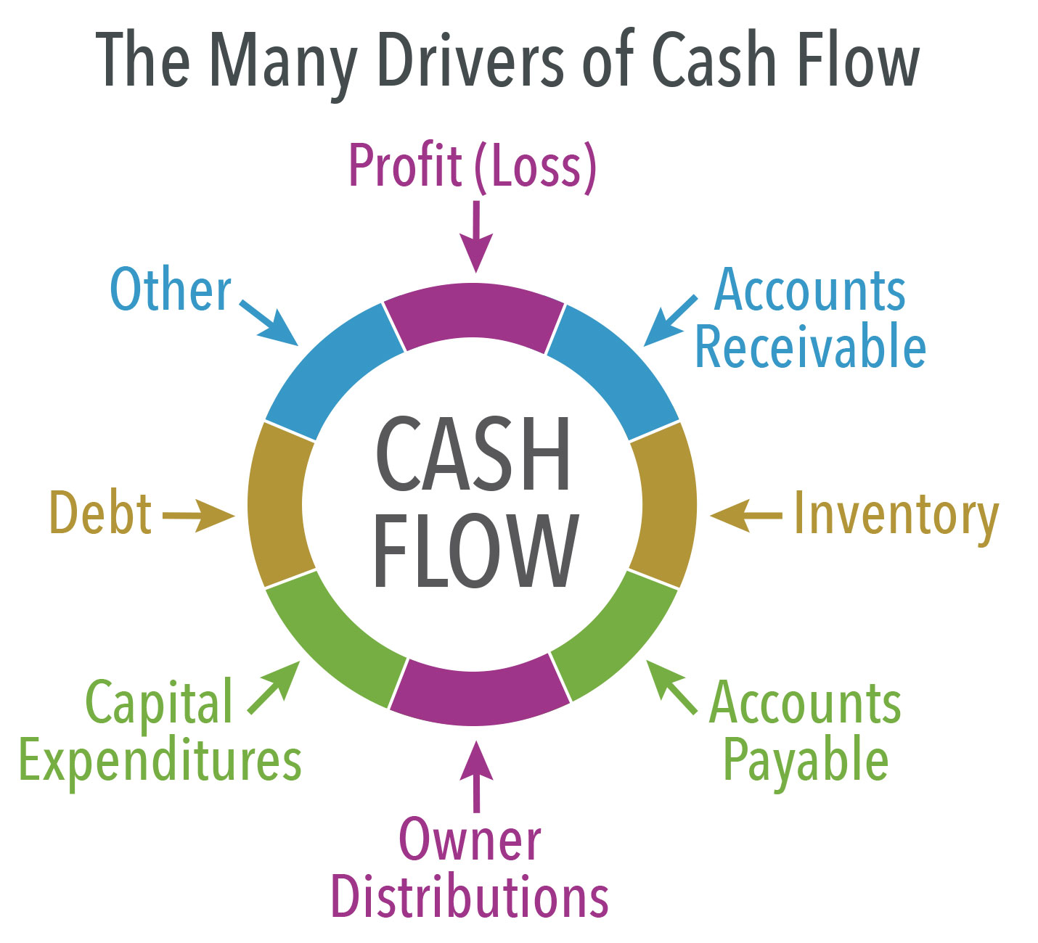
An example of how we could use cash flow to help us in our endeavors

Slide 22
Conclusion:
At SecureNet Solutions, we are dedicated to fostering a more secure and protected digital realm for businesses across Jamaica by offering cutting-edge cybersecurity solutions.
Our unwavering commitment to this mission is fortified by a comprehensive funding strategy, a captivating presentation, precise financial forecasts, and an astute cash flow management system.

Slide 23
Conclusion (ctd) :
With these formidable pillars in place, we exude confidence in our capacity to not only attain our objectives but also emerge as a preeminent force in the realm of cybersecurity.

